Slide 1


Design Pattern
Recurring Solutions to Recurring Problems
Prof. Partha Pratim Das
Module 06
CS20006: Software Engineering
Apr-21
Software Engineering
Notes:
‹#›

Slide 2
Agenda
Design Patterns
Patterns Everywhere
Fundamentals
GoF Pattern Overview
Source:
GoF Book
Apr-21
Software Engineering
Notes:
‹#›

Slide 3
Pattern’s Everywhere
Quest in Human Endeavor
Apr-21
Software Engineering
Notes:
‹#›

Slide 4
Pattern’s Everywhere in Life
Summer, Winter, Autumn, Spring:
Climatic Pattern
New Moon, Full Moon:
Lunar Pattern
Iron Filings in a Magnetic Fields:
Magnetic Pattern
Patterns in Nature
Apr-21
Software Engineering

Slide 5
Pattern’s Everywhere in Life
Bhairavi, Malkosh, Hansadhwani:
Musical Pattern
Sonnet:
Poetic Pattern
Bibi #1, Hero #1, Jodi #1, Premi #1:
Bollywood Pattern
Heshtoric Win, The Damned, Grave end to Mutiny:
Media Pattern
Simple, Complex, Compound Sentences:
Grammatical Pattern
Patterns in Art / Humanities
Apr-21
Software Engineering

Slide 6
Pattern’s Everywhere in Life
4-3-3, 5-2-3, 10:
Soccer Pattern
Castling:
Chess Pattern
Patterns in Sport
Apr-21
Software Engineering

Slide 7
Pattern’s Everywhere in Life
BTK (Bind-Torture-Kill: Dennis Lader), Stone Man:
Serial Killer Pattern
9/11, 7/11, 26/11:
Terror Pattern
Mughal, Gandhi:
Dynastic Pattern
Patterns in Crime / Politics
Apr-21
Software Engineering

Slide 8
Pattern’s Everywhere in Life
Baluchari, Benarasi, Pachhampalli:
Silk Pattern
Palace, House, Apartment, Condo:
Housing Pattern
Recipe:
Cooking Pattern
Times New Roman, Arial, Verdana, Tahoma:
Typesetting Pattern
Patterns in Construction
Apr-21
Software Engineering

Slide 9
Pattern’s Everywhere in Life
Jiang Qing, Zhang Chunqiao, Yao Wenyuan, Wang Hongwen
Cultural-Revolution excesses exposed on Mao's death
Wang Dongxing, Wu De, Ji Dengkui, Chen Xilian
Hua Guofeng's clique; Crushed in 1980 by Deng Xiaoping
Corrupt Collusion Pattern
Erich Gamma, Richard Helm, Ralph Johnson, John Vlissides
GoF Book on Pattern
Creative Consortium Pattern
Patterns in Collaboration
Apr-21
Software Engineering
Notes:
‹#›
Cultural-Revolution (1966-76) excesses exposed on Mao's death (1976)

Slide 10
Pattern’s Everywhere in Life
Semi-Group, Monoid, Group, Abelian Group:
Algebraic Pattern
Unconditional Branch, Conditional Branch, Definite Loop, Indefinite Loop, Recursion:
Programming Pattern
Divide-and-Conquer, Greedy, Dynamic Programming, Branch-and-Bound:
Algorithmic Pattern
Factory, Iterator, Visitor, Singleton:
Design Pattern
Patterns in Computation
Apr-21
Software Engineering

Slide 11
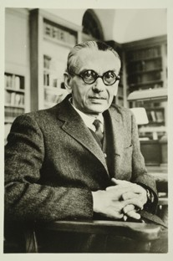
Pattern Pioneers
Kurt Godel
(1906-1978)
Austrian-American Logician
This sentence is false
Who is he?
Apr-21
Software Engineering

Slide 12


Pattern Pioneers
Champion of
Graphic Patterns
Who is he?
Apr-21
Software Engineering

Slide 13
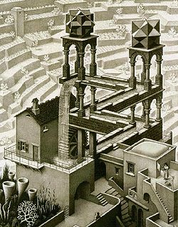
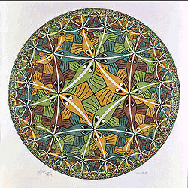
Pattern Pioneers
Maurits Cornelis Escher
(1898-1972)
Dutch Graphic Artist
Apr-21
Software Engineering

Slide 14
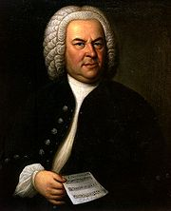
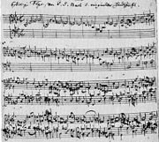
Pattern Pioneers
Johann Sebastian Bach
(1685-1750)
German Composer & Organist
Who is he?
Apr-21
Software Engineering

Slide 15
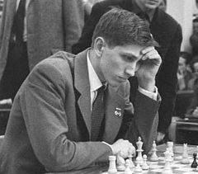

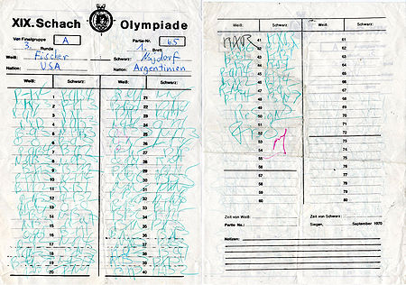
Pattern Pioneers
Robert James Fisher
(1943-2008)
US Chess World Champ
Who is he?
Apr-21
Software Engineering

Slide 16
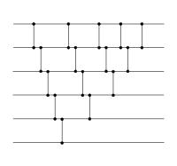
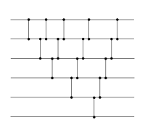
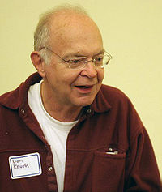
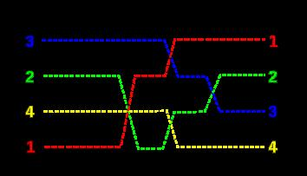
Pattern Pioneers
Donald Ervin Knuth
(1938-)
Father of Analysis of Algorithms
Who is he?
Apr-21
Software Engineering

Slide 17
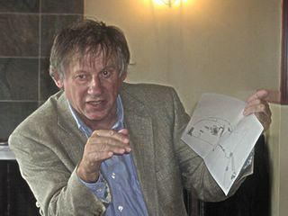
Pattern Pioneers
There is one timeless way of building.
It is a thousand years old, and the
same today as it has ever been.
The great traditional buildings of
the past, the villages and tents and
temples in which man feels at home,
have always been made by people
who were very close to the center
of this way. It is not possible to make
great buildings, or great towns,
beautiful places, places where you
feel yourself, places where you feel
alive, except by following this way.
And, as you will see, this way will
lead anyone who looks for it to
buildings which are themselves as
ancient in their form, as the trees
and hills, and as our faces are.
Christopher Alexander
(1936-)
Architect – The Pattern Language
Who is he?
Apr-21
Software Engineering

Slide 18
Patterns in Life: Take Back
Patterns Pervade
Patterns Drive Research
Patterns are the greatest exploits for Design
Apr-21
Software Engineering

Slide 19
Patterns in Computation
Multitude of Reuse
Apr-21
Software Engineering
Notes:
‹#›

Slide 20
Types of Patterns
Architectural patterns
Design patterns
Code patterns (Idioms)‏
Apr-21
Software Engineering

Slide 21
Architectural Patterns
Architectural designs concern the overall structure of software systems
Architectural designs cannot directly be programmed
Form a basis for more detailed design
While working out the high-level solutions to very large problems
Architectural patterns are relevant
Apr-21
Software Engineering

Slide 22
Architectural Patterns
Examples
File Sharing Architecture
Client/Server architecture
n-Tiered Architecture
Service Oriented Architecture (SOA)
Apr-21
Software Engineering

Slide 23
Design Patterns
A design pattern
Suggests a scheme for structuring the classes in a design solution
Also, defines the interactions required among those classes
Design pattern solutions are described in terms of
Classes, their instances, their roles and collaborations.
Apr-21
Software Engineering

Slide 24
History of Design Patterns
The concept of a "pattern":
First expressed in Christopher Alexander's work A Pattern Language in 1977 (2543 patterns)
In 1990:
Gang of Four or "GoF" (Gamma, Helm, Johnson, Vlissides) compile a catalog of design patterns
Design pattern: a solution to a common software problem in a certain context
Example: Iterator pattern The Iterator pattern defines an interface that declares methods for sequentially accessing the objects in a collection.
Apr-21
Software Engineering

Slide 25
Idioms
Idioms are a low-level patterns:
Programming language-specific
Describes how to implement a solution to a particular problem using a given programming language
Apr-21
Software Engineering

Slide 26
Idioms
Idioms in English language:
A group of words that has meaning different from a simple juxtaposition of the meanings of the individual words
Example: “Raining cats and dogs”
A C idiom:
for(i=0;i<1000;i++) { }
Apr-21
Software Engineering

Slide 27
Patterns versus Idioms
A pattern:
Describes a recurring problem
Describes a core solution
Is capable of generating many distinct designs
An Idiom though describes a recurring problem is more restricted:
Provides a specific solution, with fewer variations
Applies only to a narrow context
e.g., the C++ language
Apr-21
Software Engineering

Slide 28
Antipattern
If a pattern represents a best practice:
Antipattern represents lessons learned from a bad design
Antipatterns help to recognise deceptive solutions:
That appear attractive at first, but turn out to be a liability later
Apr-21
Software Engineering

Slide 29
Patterns versus Algorithms
Are patterns and algorithms identical concepts?
After all, both target to provide reusable solutions to problems!
Algorithms primarily focus on solving problems with reduced space and/or time requirements:
Patterns focus on understandability and maintainability of design and easier development
Apr-21
Software Engineering

Slide 30
Design Patterns
Search of Similarities in OOD
Apr-21
Software Engineering
Notes:
‹#›

Slide 31
What is a Design Pattern?
A Design Pattern
describes a problem
Occurring over and over again (in software engineering)
describes the solution
Sufficiently generic
Applicable in a wide variety of contexts.
Recurring Solution to a Recurring Problem
Apr-21
Software Engineering

Slide 32
Essential Elements of a Design Pattern
Pattern Name: Descriptor for a design problem, its solutions, and their consequences.
Problem: Where to apply the pattern and its associated context.
Solution: Elements that make up the design, their relationships, responsibilities, and collaborations.
Consequences: Results and trade-offs in applying the pattern.
Apr-21
Software Engineering

Slide 33
Example Pattern
Pattern Name
Iterator
Problem
How to serve Patients at a Doctor’s Clinic
Solution
Front-desk manages the order for patients to be called
By Appointment
By Order of Arrival
By Extending Gratitude
By Exception
…
Consequences
Patient Satisfaction
Clinic’s Efficiency
Doctor’s Productivity
Apr-21
Software Engineering

Slide 34
Describing a Design Pattern
Every Design Pattern is Described in a specific format
We first illustrate an example before presenting the generic format for description
Example of Iterator Pattern
Apr-21
Software Engineering

Slide 35
Iterator Pattern
CONTAINERS
Array
Vector
List
Stack
Queue
Tree
Pattern Name and Classification:
Iterator
Behavioral
Intent
Provide a way to access
the elements
of an aggregate object (container)
sequentially
without exposing its underlying representation.
ACCESS
Read
Write
Read-Write
SEQUENTIAL
Forward
Backward
Bidirectional
Random
Apr-21
Software Engineering

Slide 36
Iterator Pattern
Also Known As
Cursor
Motivation
An aggregate object (list) should have a way to access its elements without exposing its internal structure.
There is a need to traverse the list in different ways, depending on a specific task.
Multiple traversals may be pending on the same list.
The key idea in this pattern is to take the responsibility for access and traversal out of the list object and put it into an iterator object.
Apr-21
Software Engineering

Slide 37
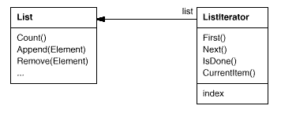
Iterator Pattern
Motivation
Apr-21
Software Engineering

Slide 38
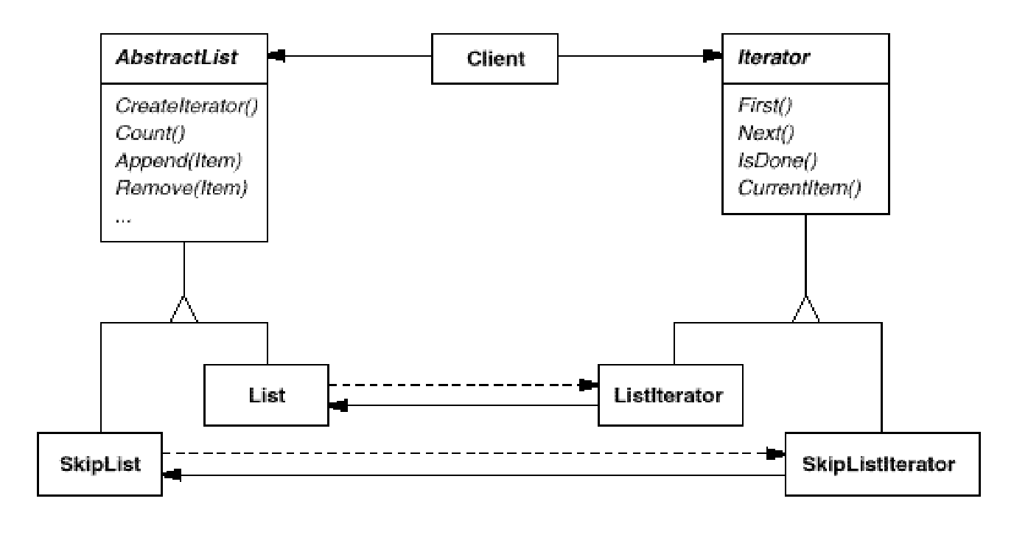
Iterator Pattern
Motivation
Apr-21
Software Engineering

Slide 39
Iterator Pattern
Applicability
to access an aggregate object's contents without exposing its internal representation.
to support multiple traversals of aggregate objects.
to provide a uniform interface for traversing different aggregate structures (that is, to support polymorphic iteration).
Apr-21
Software Engineering

Slide 40
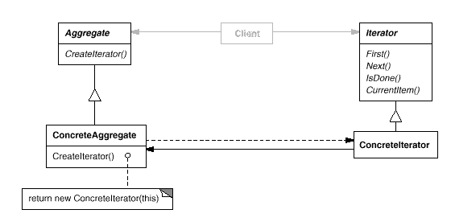
Iterator Pattern
Structure
Apr-21
Software Engineering

Slide 41
Iterator Pattern
Participants
Iterator
defines an interface for accessing and traversing elements.
ConcreteIterator
implements the Iterator interface.
keeps track of the current position in the traversal of the aggregate.
Aggregate
defines an interface for creating an Iterator object.
ConcreteAggregate
implements the Iterator creation interface to return an instance of the proper ConcreteIterator.
Apr-21
Software Engineering

Slide 42
Iterator Pattern
Collaborations
A ConcreteIterator keeps track of the current object in the aggregate and can compute the succeeding object in the traversal.
Consequences
It supports variations in the traversal of an aggregate.
Iterators simplify the Aggregate interface.
More than one traversal can be pending on an aggregate.
Apr-21
Software Engineering

Slide 43
Iterator Pattern
Implementation
Who controls the iteration?
External Iteration
Internal Iteration
Who defines the traversal algorithm?
How robust is the iterator?
What happens if items are inserted / deleted?
Additional Iterator operations
Using polymorphic iterators in C++.
allocated dynamically by a factory method
the client is responsible for deleting them
Iterators may have privileged access
friend class
Iterators for composites
Null iterators
Apr-21
Software Engineering

Slide 44
Iterator Pattern
Sample Code – Follows in the next few slides.
Apr-21
Software Engineering

Slide 45
Iterator Pattern
template <class Item>
class List {
public:
List(long size = DEFAULT_LIST_CAPACITY);
long Count() const;
Item& Get(long index) const;
// ...
};
Apr-21
Software Engineering

Slide 46
Iterator Pattern
template <class Item>
class Iterator {
public:
virtual void First() = 0;
virtual void Next() = 0;
virtual bool IsDone() const = 0;
virtual Item CurrentItem() const = 0;
protected:
Iterator();
};
Apr-21
Software Engineering

Slide 47
Iterator Pattern
template <class Item>
class ListIterator : public Iterator<Item> {
public:
ListIterator(const List<Item>* aList);
virtual void First();
virtual void Next();
virtual bool IsDone() const;
virtual Item CurrentItem() const;
private:
const List<Item>* _list;
long _current;
};
Apr-21
Software Engineering

Slide 48
Iterator Pattern
template <class Item>
ListIterator<Item>::ListIterator (
const List<Item>* aList
) : _list(aList), _current(0) {
}
template <class Item>
void ListIterator<Item>::First () {
current = 0;
}
Apr-21
Software Engineering

Slide 49
Iterator Pattern
template <class Item>
void ListIterator<Item>::Next () {
current++;
}
template <class Item>
bool ListIterator<Item>::IsDone () const {
return _current >= _list->Count();
}
Apr-21
Software Engineering

Slide 50
Iterator Pattern
template <class Item>
Item ListIterator<Item>::CurrentItem () const {
if (IsDone()) {
throw IteratorOutOfBounds;
}
return _list->Get(_current);
}
Apr-21
Software Engineering

Slide 51
Iterator Pattern
void PrintEmployees (Iterator<Employee*>& i) {
for (i.First(); !i.IsDone(); i.Next()) {
i.CurrentItem()->Print();
}
}
List<Employee*>* employees;
// ...
ListIterator<Employee*> forward(employees);
ReverseListIterator<Employee*> backward(employees);
PrintEmployees(forward);
PrintEmployees(backward);
Apr-21
Software Engineering

Slide 52
Iterator Pattern (STL list)
#include <iostream>
#include <list>
int main () {// constructing lists
std::list<int> first; // empty list of ints
std::list<int> second (4,100); // four ints with value 100
std::list<int> third (second.begin(),second.end()); // iterating through second
std::list<int> fourth (third); // a copy of third
// the iterator constructor can also be used to construct from arrays:
int myints[] = {16,2,77,29};
std::list<int> fifth (myints, myints + sizeof(myints) / sizeof(int) );
std::cout << "The contents of fifth are: ";
for (std::list<int>::iterator it = fifth.begin(); it != fifth.end(); it++)
std::cout << *it << ' ';
std::cout << '\n';
return 0;
}
Normal Constructor (2 Params): (1, 1)
The contents of fifth are: 16 2 77 29
Apr-21
Software Engineering

Slide 53
Iterator Pattern (STL map)
#include <iostream>
#include <map>
int main () { // map::begin/end
std::map<char,int> mymap;
std::map<char,int>::iterator it;
mymap['b'] = 100;
mymap['a'] = 200;
mymap['c'] = 300;
// show content:
for (std::map<char,int>::iterator it=mymap.begin(); it!=mymap.end(); ++it)
std::cout << it->first << " => " << it->second << '\n';
return 0;
}
Normal Constructor (2 Params): (1, 1)
a => 200
b => 100
c => 300
Apr-21
Software Engineering

Slide 54
Iterator Pattern
Known Uses
Iterators are common in object-oriented systems
Related Patterns
Composite:
Iterators are often applied to recursive structures such as Composites.
Factory Method:
Polymorphic iterators rely on factory methods to instantiate the appropriate Iterator subclass.
Memento:
Often used in conjunction with the Iterator pattern. An iterator can use a memento to capture the state of iteration. The iterator stores the memento internally.
Apr-21
Software Engineering

Slide 55
Describing a Design Pattern
Pattern Name and Classification
The pattern's name conveys the essence of the pattern succinctly.
Intent
A short statement on:
What does the design pattern do?
What is its rationale and intent?
What particular design issue or problem does it address?
Also Known As
Other well-known names for the pattern.
Apr-21
Software Engineering

Slide 56
Describing a Design Pattern
Motivation
A scenario that illustrates a design problem and how the class and object structures in the pattern solve the problem.
Applicability
What are the situations in which the design pattern can be applied?
What are examples of poor designs that the pattern can address?
How can you recognize these situations?
Apr-21
Software Engineering

Slide 57
Describing a Design Pattern
Structure
A graphical representation of the classes in the pattern using a notation based on the Object Modeling Technique (OMT) – specifically UML.
Participants
The classes and/or objects participating in the design pattern and their responsibilities.
Collaborations
How the participants collaborate to carry out their responsibilities?
Apr-21
Software Engineering

Slide 58
Describing a Design Pattern
Consequences
How does the pattern support its objectives?
What are the trade-offs and results of using the pattern?
What aspect of system structure does can be varied independently?
Implementation
What pitfalls, hints, or techniques should you be aware of when implementing the pattern?
Are there language-specific issues?
Apr-21
Software Engineering

Slide 59
Describing a Design Pattern
Sample Code
Code fragments to implement the pattern in specific language (C++ or C# or Java).
Known Uses
Examples of the pattern found in real systems.
Related Patterns
What design patterns are closely related to this one?
What are the important differences?
With which other patterns should this one be used?
Apr-21
Software Engineering

Slide 60
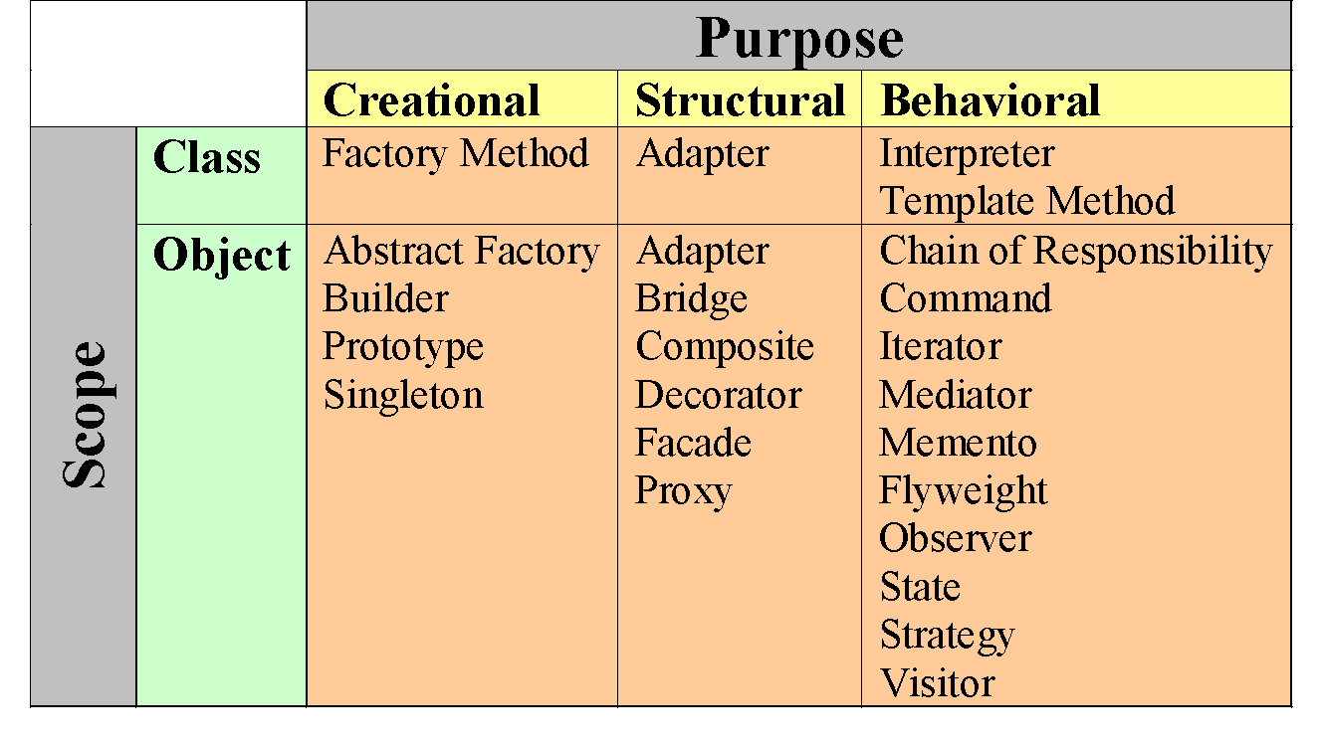
Catalogue of Design Patterns (GoF)
Apr-21
Software Engineering

Slide 61
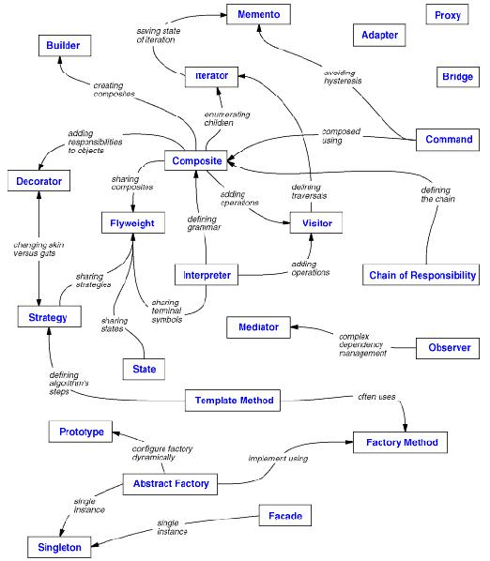
Apr-21
Software Engineering

Slide 62
Pros of Design Patterns
Help capture and disseminate expert knowledge.
Promotes reuse and avoid mistakes.
Provide a common vocabulary:
Help improve communication among the developers.
Reduce the number of design iterations:
Help improve the design quality and designer productivity.
Apr-21
Software Engineering

Slide 63
Pros of Design Patterns
Patterns solve software structural problems attributable to:
Abstraction,
Encapsulation
Information hiding
Separation of concerns
Coupling and cohesion
Separation of interface and implementation
Single point of reference
Divide and conquer
Apr-21
Software Engineering

Slide 64
Cons of Design Patterns
Design patterns do not directly lead to code reuse.
To help select the right design pattern at the right point during a design exercise.
At present no methodology exists
Apr-21
Software Engineering

Slide 65
Callable Entities in C / C++
Function Pointer Recap
Apr-21
Software Engineering
Notes:
‹#›

Slide 66
Callable Entities
A Callable Entity is an object that
Can be called using the function call syntax
Supports operator()
Such objects are often called
A Function Object or
A Functor
Some authors do distinguish between Callable Entities, Function Objects and Functors.
Apr-21
Software Engineering
Notes:
‹#›

Slide 67
Callable Entities in C++
Function-like Macros
C Functions (Global or in Namespace)
Member Functions
Static
Non-Static
Pointers to Functions
C Functions
Member Functions
Static
Non-Static
References to functions
Acts like const pointers to functions
Functors – Objects that define operator()
Apr-21
Software Engineering
Notes:
‹#›

Slide 68
Function Pointers
Points to the address of a function
Ordinary C functions
Static C++ member functions
Non-static C++ member functions
Points to a function with a specific signature
List of Calling Parameter Types
Return-Type
Calling Convention
Apr-21
Software Engineering
Notes:
‹#›

Slide 69
Function Pointers – In C
Define a Function Pointer
int (*pt2Function) (float, char, char);
Calling Convention
int __cdecl DoIt (float a, char b, char c);
int DoIt (float a, char b, char c)
{ printf ("DoIt\n"); return a+b+c; }
Assign Address to a Function Pointer
pt2Function = &DoIt;
Compare Function Pointers
if (pt2Function == &DoIt)
{ printf ("pointer points to DoIt\n"); }
Call the Function pointed by the Function Pointer
int result = (*pt2Function) (12, ’a’, ’b’);
Apr-21
Software Engineering
Notes:
‹#›

Slide 70
Function Pointers – In C++
Define a Function Pointer
int (A::*pt2Member)(float, char, char);
Calling Convention
class A {
int DoIt (float a, char b, char c)
{ cout << “A::DoIt" << endl; return a+b+c; };
}
Assign Address to a Function Pointer
pt2Member = &A::DoIt;
Compare Function Pointers
if (pt2Member == &A::DoIt)
{ cout << "pointer points to A::DoIt" << endl; }
Call the Function pointed by the Function Pointer
int result = (*this.*pt2Member)(12, ’a’, ’b’);
Apr-21
Software Engineering
Notes:
‹#›

Slide 71
Function Reference – In C++
Define a Function Pointer
int (A::*pt2Member)(float, char, char);
Calling Convention
class A {
int DoIt (float a, char b, char c)
{ cout << “A::DoIt" << endl; return a+b+c; };
}
Assign Address to a Function Pointer
pt2Member = &A::DoIt;
Compare Function Pointers
if (pt2Member == &A::DoIt)
{ cout << "pointer points to A::DoIt" << endl; }
Call the Function pointed by the Function Pointer
int result = (*this.*pt2Member)(12, ’a’, ’b’);
Apr-21
Software Engineering
Notes:
‹#›

Slide 72
Function Pointers
Operations
Assign an Address to a Function Pointer
Compare two Function Pointers
Call a Function using a Function Pointer
Pass a Function Pointer as an Argument
Return a Function Pointer
Arrays of Function Pointers
Apr-21
Software Engineering
Notes:
‹#›

Slide 73
Function Pointers
Programming Techniques for
Replacing switch/if-statements,
Realizing user-defined late-binding, or
Functions in Dynamically Loaded Libraries
Virtual Functions
Implementing callbacks.
Apr-21
Software Engineering
Notes:
‹#›

Slide 74
Function Pointers
Calculator with operators (+, –, *, /)
// The four arithmetic operations
float Plus (float a, float b) { return a+b; }
float Minus (float a, float b) { return a-b; }
float Multiply(float a, float b) { return a*b; }
float Divide (float a, float b) { return a/b; }
// Solution with a switch-statement
void Switch(float a, float b, char opCode) {
float result;
switch (opCode) { // execute operation
case ’+’ : result = Plus (a, b); break;
case ’-’ : result = Minus (a, b); break;
case ’*’ : result = Multiply (a, b); break;
case ’/’ : result = Divide (a, b); break;
}
cout << "Switch: 2+5=" << result << endl; // display result
}
Apr-21
Software Engineering
Notes:
‹#›

Slide 75
Function Pointers – Replace Switch / IF Statements
One of the four basic Arithmetic Operations - Addition
float Plus (float a, float b) { return a+b; }
void Switch_With_Function_Pointer (float a, float b,
float (*pt2Func)(float, float))
{
float result = pt2Func(a, b);
cout << a << "+" << b << "=" << result << endl;
}
void main()
{
Switch_With_Function_Pointer(2, 5, &Plus);
}
Apr-21
Software Engineering
Notes:
‹#›

Slide 76
Function Pointers – Late Binding / Dynamically Loaded Library
A C Feature in Shared Dynamically Loaded Libraries
#include <dlfcn.h>
int main()
{
void* handle =
dlopen("hello.so",
RTLD_LAZY);
typedef
void (*hello_t)();
hello_t myHello = 0;
myHello = (hello_t)
dlsym(handle,
"hello");
myHello();
dlclose(handle);
}
#include <iostream>
using namespace std;
extern "C" void hello() {
cout << "hello"
<< endl;
}
Apr-21
Software Engineering
Notes:
‹#›

Slide 77
Function Pointers – Late Binding / Virtual Function
A C++ Feature for Polymorphic Member Functions
class A {
public:
void f();
virtual void g();
};
class B: public A {
public:
void f();
virtual void g();
};
void main() {
A a;
B b;
A *p = &b;
a.f(); // A::f()
a.g(); // A::g()
p->f();// A::f()
p->g();// B::g()
}
Apr-21
Software Engineering
Notes:
‹#›

Slide 78
Function Pointers – Callback
A Common C Feature
// Application
extern void (*func)();
void f()
{
}
void main()
{
func = &f;
g();
}
// Library
void (*func)();
void g()
{
(*func)();
}
{
Callback
Apr-21
Software Engineering
Notes:
‹#›

Slide 79
Function Pointers – Callbacks
Quick Sort Implementation using callback in ‘qsort’
int CmpFunc(const void* a, const void* b) {
int ret = (*(const int*)a > *(const int*) b)? 1:
(*(const int*)a == *(const int*) b)? 0: -1;
return ret;
}
void main() {
int field[10];
for(int c=10;c>0;c--)
field[10-c]=c;
qsort((void*) field, 10, sizeof(field[0]), CmpFunc);
}
Apr-21
Software Engineering
Notes:
‹#›

Slide 80
Function Pointers
Issues
No value semantics
Weak type checking
Two function pointers having identical signature are necessarily indistinguishable
No encapsulation for parameters
Apr-21
Software Engineering
Notes:
‹#›

Slide 81
Functors
Function Objects in C++
Apr-21
Software Engineering
Notes:
‹#›

Slide 82
Functors / Closures
Smart Functions
Functors are functions with a state.
Functors encapsulate C / C++ function pointers
Uses templates and
Engages polymorphism.
Has its own Type
A class with
zero or more private members to store the state and
an overloaded operator() to execute the function.
Usually faster than ordinary Functions
Can be used to implement callbacks.
Apr-21
Software Engineering
Notes:
‹#›

Slide 83
Basic Functor
Any class that overloads the function call operator:
void operator()();
int operator()(int, int);
double operator()(int, double);
...
Apr-21
Software Engineering
Notes:
‹#›

Slide 84
Functors: Elementary Example
int AdderFunction(int a, int b) {
return a + b;
}
class AdderFunctor {
public:
int operator()(int a, int b) {
return a + b;
}
};
void main() {
int x = 5;
int y = 7;
int z = AdderFunction(x, y);
AdderFunctor aF;
int w = aF(x, y);
}
Apr-21
Software Engineering
Notes:
‹#›

Slide 85
Functors: Examples from STL
Fill a vector with random numbers
Function Pointer rand as Function Object
vector<int> V(100);
generate(V.begin(), V.end(), rand);
Apr-21
Software Engineering
Notes:
‹#›

Slide 86
Functors: Examples from STL
Sort a vector of double by magnitude
User-defined Functor less_mag
struct less_mag: public
binary_function<double, double, bool> {
bool operator()(double x, double y)
{ return fabs(x) < fabs(y); }
};
vector<double> V; ...
sort(V.begin(), V.end(), less_mag());
Apr-21
Software Engineering
Notes:
‹#›

Slide 87
Functors: Examples from STL
Find the sum of elements in a vector
User-defined Functor adder with local state
struct adder: public
unary_function<double, void> {
adder() : sum(0) {}
double sum;
void operator()(double x) { sum += x; }
};
vector<double> V;
...
adder result =
for_each(V.begin(), V.end(), adder());
cout << "The sum is " << result.sum << endl;
Apr-21
Software Engineering
Notes:
‹#›

Slide 88
Command Design Pattern
The World of Delegation
Apr-21
Software Engineering
Notes:
‹#›

Slide 89
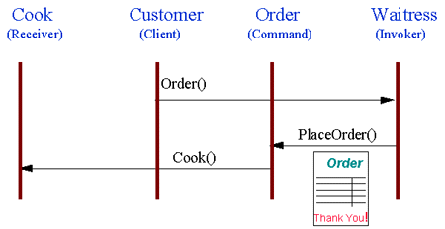
“Check @ Diner” – A Command Pattern
Customer places an Order with Waitress
Waitress writes Order on check.
Order is queued to Cook.
Apr-21
Software Engineering
Notes:
‹#›
Note that the pad of "checks" used by different diners is not dependent on the menu, and therefore they can support commands to cook many different items.

Slide 90
“Compose & Send Mail” – A Command Pattern
Sender composes a Mail with Compose Mail Editor (like Word) and presses “Send”
Mail is queued on Outbox.
SendMail thread checks the connection and send the Mails from Outbox.
Apr-21
Software Engineering
Notes:
‹#›

Slide 91
Command Pattern
Pattern Name and Classification:
Command
Behavioral
Intent
Encapsulate requests for service from an object inside other objects to allow manipulation of the requests in various ways
Also Known As
Action, Transaction
Apr-21
Software Engineering

Slide 92
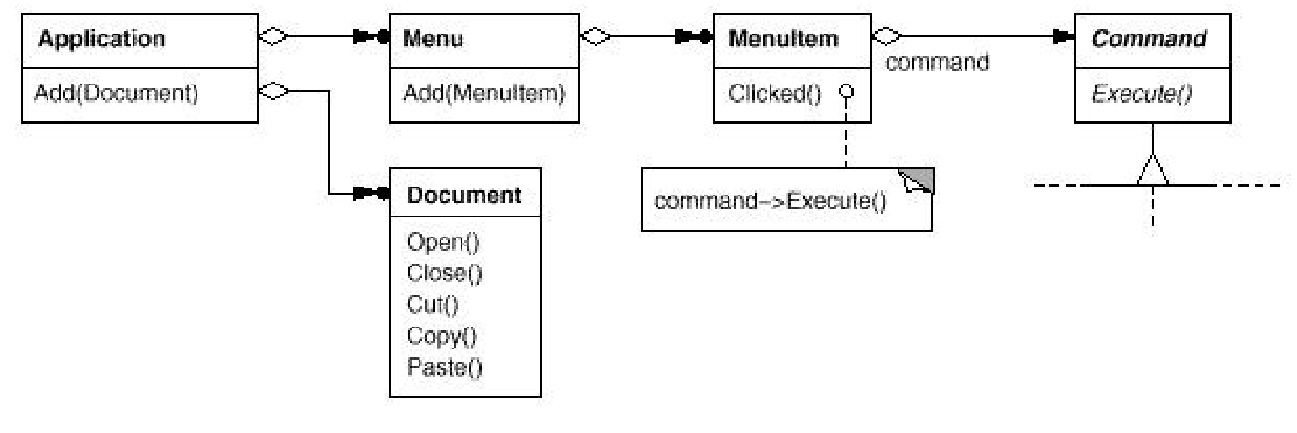
Command Pattern
Motivation
Primarily arising from GUI Toolkit
Apr-21
Software Engineering

Slide 93
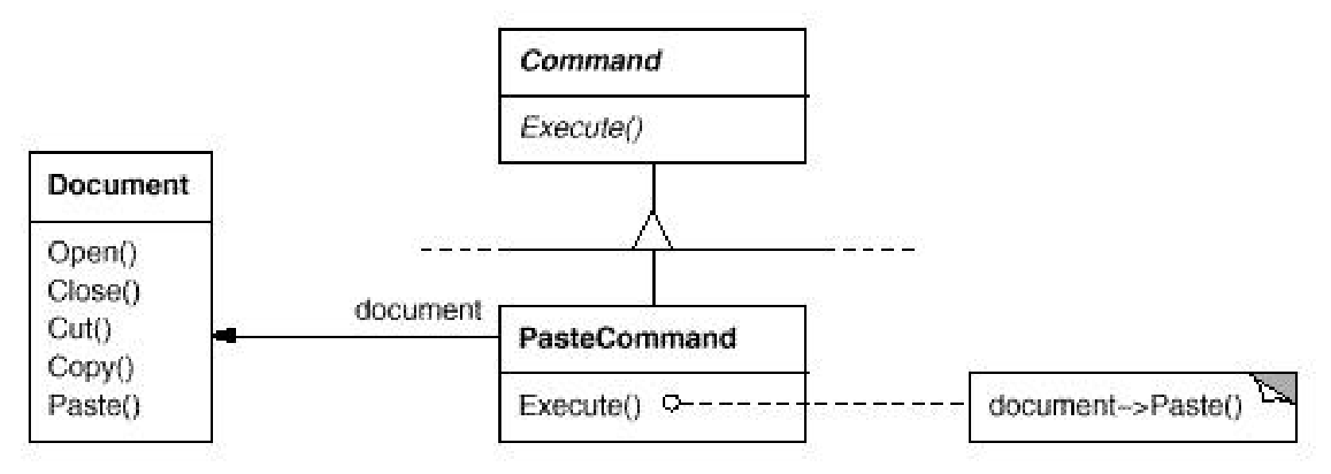
Command Pattern
Motivation
Apr-21
Software Engineering

Slide 94
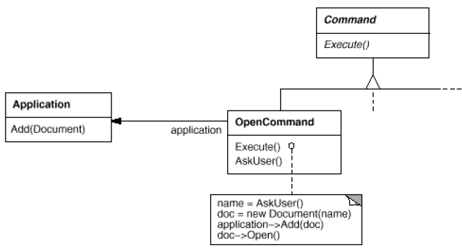
Command Pattern
Motivation
Apr-21
Software Engineering

Slide 95
Command Pattern
Applicability
The Command pattern can be used
To implement a callback function capability
To specify, queue, & execute requests at different times
To support undo and change log operations
Apr-21
Software Engineering

Slide 96
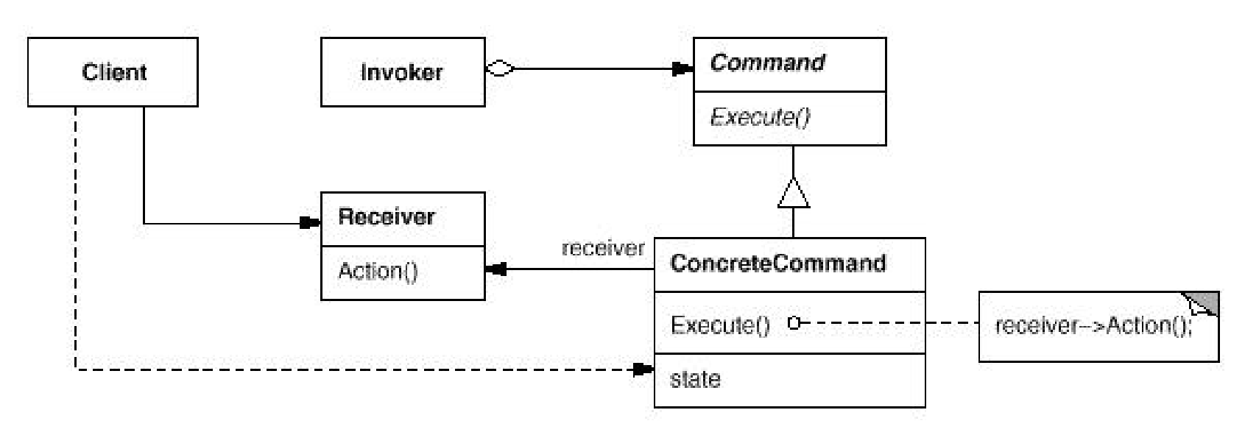
Command Pattern
Structure
Interface Separation
Time Separation
Apr-21
Software Engineering

Slide 97
Command Pattern
Participants
Command
declares an interface for executing an operation.
ConcreteCommand (PasteCommand, OpenCommand)
defines a binding between a Receiver object and an action.
implements Execute by invoking the corresponding operation(s) on Receiver.
Client (Application)
creates a ConcreteCommand object and sets its receiver.
Invoker (MenuItem)
asks the command to carry out the request.
Receiver (Document, Application)
knows how to perform the operations associated with carrying out a request. Any class may serve as a Receiver.
Apr-21
Software Engineering

Slide 98
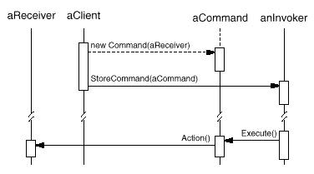
Command Pattern
Collaborations
Apr-21
Software Engineering

Slide 99
Command Pattern
Consequences
Command decouples the object that invokes the operation from the one that knows how to perform it
Commands are first-class objects. They can be manipulated and extended like any other object.
Commands can be made into a composite command
Apr-21
Software Engineering

Slide 100
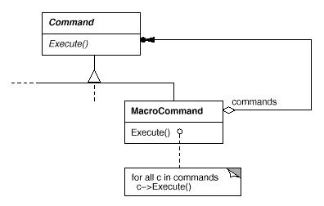
Command Pattern
Macro / Composite Command
Apr-21
Software Engineering

Slide 101
Command Pattern
Implementation Issues
How intelligent should a command object be?
Dumb: Delegates the required action to a receiver object
Smart: Implements everything itself without delegating to a receiver object at all
Use Functor?
Active Command:
A functor object usually implements the desired behavior itself without delegation to another object.
Forwarding Command:
A command object frequently delegates the desired behavior to another receiver object.
Apr-21
Software Engineering

Slide 102
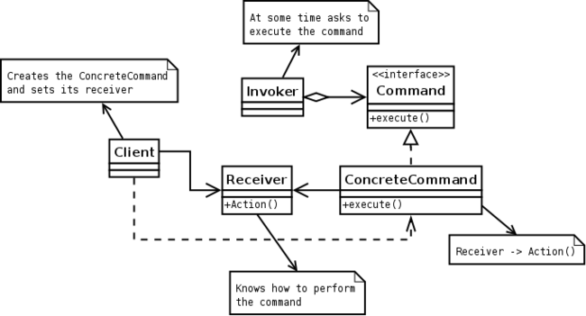
Command Pattern: Request-in-Object
Apr-21
Software Engineering

Slide 103
Sample Command Pattern Usage
Multi-level undo / redo
The program can keep a pair of stacks of commands.
Transactional behavior
Rollback for all-or-none operations
Installers / Databases.
Two-phase commit.
Progress bars
Apr-21
Software Engineering

Slide 104
Sample Command Pattern Usage
Wizards
What we see
Several pages of configuration for a single action.
Action fires when the user clicks the "Finish" button.
What we need
Separate user interface code from application code
Implement the wizard using a command object.
The command class contains no user interface code.
How it works
Created when the wizard is first displayed.
Each wizard page stores its GUI changes in the command object.
"Finish" simply triggers a call to execute().
Apr-21
Software Engineering

Slide 105
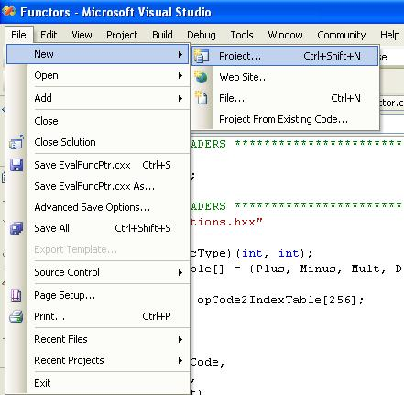
Sample Command Pattern Usage
Apr-21
Software Engineering

Slide 106
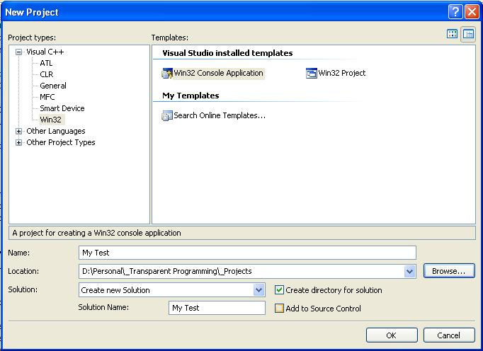
Sample Command Pattern Usage
Apr-21
Software Engineering

Slide 107
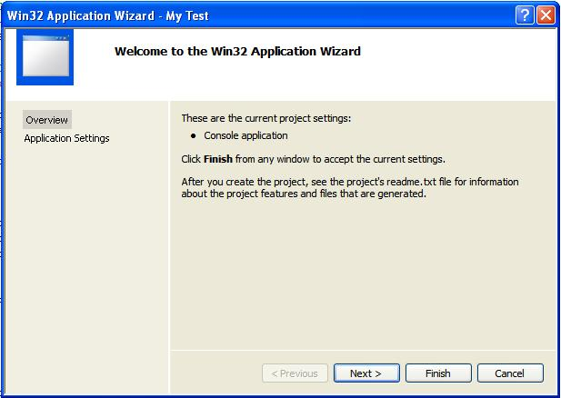
Sample Command Pattern Usage
Apr-21
Software Engineering

Slide 108
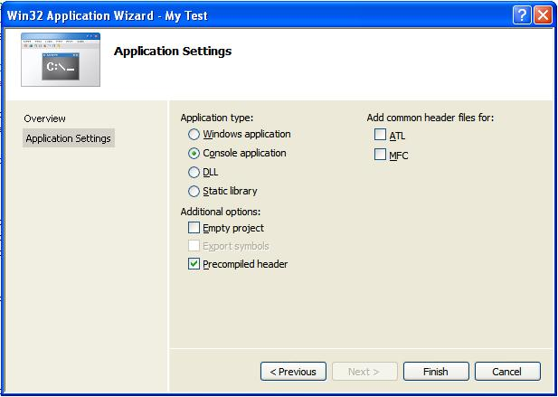
Sample Command Pattern Usage
Apr-21
Software Engineering

Slide 109
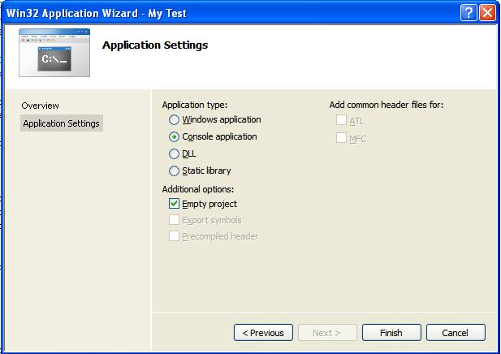
Sample Command Pattern Usage
Apr-21
Software Engineering

Slide 110
Sample Command Pattern Usage
GUI buttons and menu items
In Swing and Borland Delphi programming, an Action is a command object.
Thread pools / Parallel Processing
Master/Worker pattern
Macro recording
Command across Network
Player actions in computer games.
Mobile Code
Deliver a new behavior to remote locations
Apr-21
Software Engineering

Slide 111
Implement Command Pattern
How to Encapsulate a Command ?
Command Encapsulation
Function Object
Apr-21
Software Engineering

Slide 112
Command Pattern Example Source: Command in C++
#include <iostream>
#include <string>
/**
* The Command interface declares a method for executing a command.
*/
class Command {
public:
virtual ~Command() {
}
virtual void Execute() const = 0;
};
/**
* Some commands can implement simple operations on their own.
*/
class SimpleCommand : public Command {
private:
std::string pay_load_;
public:
explicit SimpleCommand(std::string pay_load) : pay_load_(pay_load) { }
void Execute() const override {
std::cout <<
"SimpleCommand: See, I can do simple things like printing (" <<
this->pay_load_ << ")\n";
}
};
Apr-21
Software Engineering

Slide 113
Command Pattern Example
/**
* The Receiver classes contain some important business logic. They know how to
* perform all kinds of operations, associated with carrying out a request. In
* fact, any class may serve as a Receiver.
*/
class Receiver {
public:
void DoSomething(const std::string &a) {
std::cout << "Receiver: Working on (" << a << ".)\n";
}
void DoSomethingElse(const std::string &b) {
std::cout << "Receiver: Also working on (" << b << ".)\n";
}
};
Apr-21
Software Engineering

Slide 114
Command Pattern Example
/**
* However, some commands can delegate more complex operations to other objects,
* called "receivers."
*/
class ComplexCommand : public Command {
/**
* @var Receiver
*/
private:
Receiver *receiver_;
/**
* Context data, required for launching the receiver's methods.
*/
std::string a_;
std::string b_;
/**
* Complex commands can accept one or several receiver objects along with any
* context data via the constructor.
*/
public:
ComplexCommand(Receiver *receiver, std::string a, std::string b) :
receiver_(receiver), a_(a), b_(b) { }
Apr-21
Software Engineering

Slide 115
Command Pattern Example
/**
* Commands can delegate to any methods of a receiver.
*/
void Execute() const override {
std::cout <<
"ComplexCommand: Complex stuff should be done by a receiver object.\n";
this->receiver_->DoSomething(this->a_);
this->receiver_->DoSomethingElse(this->b_);
}
};
Apr-21
Software Engineering

Slide 116
Command Pattern Example
/**
* The Invoker is associated with one or several commands. It sends a request to
* the command.
*/
class Invoker {
/**
* @var Command
*/
private:
Command *on_start_;
/**
* @var Command
*/
Command *on_finish_;
/**
* Initialize commands.
*/
public:
~Invoker() {
delete on_start_;
delete on_finish_;
}
void SetOnStart(Command *command) { this->on_start_ = command; }
void SetOnFinish(Command *command) { this->on_finish_ = command; }
Apr-21
Software Engineering

Slide 117
Command Pattern Example
void DoSomethingImportant() {
std::cout << "Invoker: Does anybody want something done before I begin?\n";
if (this->on_start_) {
this->on_start_->Execute();
}
std::cout << "Invoker: ...doing something really important...\n";
std::cout << "Invoker: Does anybody want something done after I finish?\n";
if (this->on_finish_) {
this->on_finish_->Execute();
}
}
};
Apr-21
Software Engineering

Slide 118
Command Pattern Example
/**
* The client code can parameterize an invoker with any commands.
*/
int main() {
Invoker *invoker = new Invoker;
invoker->SetOnStart(new SimpleCommand("Say Hi!"));
Receiver *receiver = new Receiver;
invoker->SetOnFinish(new ComplexCommand(receiver, "Send email", "Save report"));
invoker->DoSomethingImportant();
delete invoker;
delete receiver;
return 0;
}
OUTPUT:
Invoker: Does anybody want something done before I begin?
SimpleCommand: See, I can do simple things like printing (Say Hi!)
Invoker: ...doing something really important...
Invoker: Does anybody want something done after I finish?
ComplexCommand: Complex stuff should be done by a receiver object.
Receiver: Working on (Send email.)
Receiver: Also working on (Save report.)
Apr-21
Software Engineering

Slide 119
Command Pattern
Sample Codes
Functor Codes
Apr-21
Software Engineering

Slide 120
Singleton Design Patterns
The UNIQUE Object
Apr-21
Software Engineering
Notes:
‹#›

Slide 121
Singleton Pattern
Problem:
Managing entities with one-instance-at-a-time
Office of the Director of IIT
Heart in a Human Body
cout, cin, cerr, clog …
Solution:
Protect creation and Have unique access only
Consequences:
Synchronization needed for multi-threaded use
Note:
Closely related to Monostate Pattern
Apr-21
Software Engineering

Slide 122
Singleton Pattern
Pattern Name and Classification:
Singleton
Creational
Intent
Ensure a class only has one instance, and provide a global point of access to it.
Also Known As
Apr-21
Software Engineering

Slide 123
Singleton Pattern
Motivation
It's important for some classes to have exactly one instance.
How do we ensure that a class has only one easily accessible instance? A global variable makes an object accessible, but it doesn't keep you from instantiating multiple objects.
Make the class responsible for keeping track of its sole instance.
Apr-21
Software Engineering

Slide 124
Singleton Pattern
Applicability
Use the Singleton pattern when l there must be exactly one instance of a class, and it must be accessible to clients from a well-known access point.
when the sole instance should be extensible by subclassing, and clients should be able to use an extended instance without modifying their code.
Apr-21
Software Engineering

Slide 125
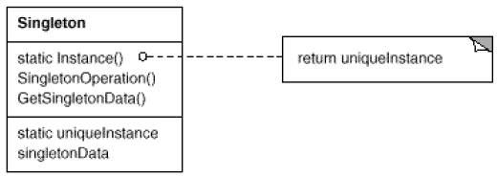
Singleton Pattern
Structure
Apr-21
Software Engineering

Slide 126
Singleton Pattern
Participants
Singleton
defines an Instance operation that lets clients access its unique instance. Instance is a class operation (that is, a static member function in C++).
may be responsible for creating its own unique instance.
Collaborations
Clients access a Singleton instance solely through Singleton's Instance operation.
Apr-21
Software Engineering

Slide 127
Singleton Pattern
Consequences
Controlled access to sole instance.
Reduced name space.
Permits refinement of operations and representation.
Permits a variable number of instances.
More flexible than class operations.
Apr-21
Software Engineering

Slide 128
Singleton Pattern
Implementation
Ensuring a unique instance. The Singleton class is declared as
class Singleton {
public: static Singleton* Instance();
protected: Singleton();
private: static Singleton* _instance;
};
Apr-21
Software Engineering

Slide 129
Singleton Pattern
Implementation
The corresponding implementation is
Singleton* Singleton::_instance = 0;
Singleton* Singleton::Instance () {
if (_instance == 0) {
_instance = new Singleton; }
return _instance;
}
Note: It isn't enough to define the singleton as a global or static object and then rely on automatic initialization
Apr-21
Software Engineering

Slide 130
Singleton Pattern
Implementation
Subclassing the Singleton class. Use a Registry. The registry maps between string names and singletons.
class Singleton { public:
static void Register(const char* name, Singleton*);
static Singleton* Instance();
protected:
static Singleton* Lookup(const char* name);
private: static Singleton* _instance;
static List<NameSingletonPair>* _registry;
};
Apr-21
Software Engineering

Slide 131
Singleton Pattern
Implementation
Subclassing the Singleton class.
Singleton* Singleton::Instance () {
if (_instance == 0) {
const char* singletonName = getenv("SINGLETON");
// Environment supplies this at startup
_instance = Lookup(singletonName);
// Returns 0 if there's no such singleton
}
return _instance;
}
Apr-21
Software Engineering

Slide 132
Singleton Pattern
Implementation
Subclassing the Singleton class.
MySingleton::MySingleton() {
// ...
Singleton::Register("MySingleton", this);
}
static MySingleton theSingleton;
Apr-21
Software Engineering

Slide 133
Singleton Pattern
Sample Code
Suppose we define a MazeFactory class for building mazes. MazeFactory defines an interface for building different parts of a maze
Subclasses can redefine the operations to return instances of specialized product classes, like BombedWall objects instead of plain Wall objects.
Maze application needs only one instance of a maze factory
Apr-21
Software Engineering

Slide 134
Singleton Pattern
class MazeFactory {
public:
static MazeFactory* Instance();
// existing interface goes here
protected:
MazeFactory();
private:
static MazeFactory* _instance;
};
Apr-21
Software Engineering

Slide 135
Singleton Pattern
The corresponding implementation is
MazeFactory* MazeFactory::_instance = 0;
MazeFactory* MazeFactory::Instance () {
if (_instance == 0) {
_instance = new MazeFactory;
}
return _instance;
}
Apr-21
Software Engineering

Slide 136
Singleton Pattern
With subclasses of MazeFactory
MazeFactory* MazeFactory::Instance () {
if (_instance == 0) {
const char* mazeStyle = getenv("MAZESTYLE");
if (strcmp(mazeStyle, "bombed") == 0) {
_instance = new BombedMazeFactory;
} else if (strcmp(mazeStyle, "enchanted") == 0) {
_instance = new EnchantedMazeFactory;
// ... other possible subclasses
} else { // default
_instance = new MazeFactory; }
}
return _instance;
}
Apr-21
Software Engineering

Slide 137
Singleton Pattern
Alternates: With subclasses of MazeFactory
Registry Approach
Use Dynamic Linking
Apr-21
Software Engineering

Slide 138
Singleton Pattern
Known Uses
Singletons are common as the ‘context’ object in any system.
Common singletons are: streams, message queue etc.
Related Patterns
Many patterns can be implemented using the Singleton pattern. For example, Abstract Factory, Builder, and Prototype.
Apr-21
Software Engineering

Slide 139
Visitor Design Patterns
Adding Methods to a Object Structure
Double Dispatch
Apr-21
Software Engineering
Notes:
‹#›

Slide 140
Visitor Pattern
Pattern Name and Classification:
Visitor
Behavioral
Intent
Represent an operation to be performed on the elements of an object structure. Visitor lets you define a new operation without changing the classes of the elements on which it operates.
Also Known As
Apr-21
Software Engineering

Slide 141
Visitor Pattern
Motivation
An object structure (multiple hierarchies possible) is given – this rarely change
Number of operations to be performed on the classes of the hierarchy
All operations may not be defined for all classes
Need to add operations without changing (recompiling the hierarchy)
Apr-21
Software Engineering

Slide 142
Visitor Pattern
Applicability
Use the Visitor pattern when an object structure contains many classes of objects with differing interfaces, and you want to perform operations on these objects that depend on their concrete classes.
Apr-21
Software Engineering

Slide 143
Visitor Pattern
Applicability
many distinct and unrelated operations need to be performed on objects in an object structure, and you want to avoid "polluting" their classes with these operations. Visitor lets you keep related operations together by defining them in one class. When the object structure is shared by many applications, use Visitor to put operations in just those applications that need them.
Apr-21
Software Engineering

Slide 144
Visitor Pattern
Applicability
the classes defining the object structure rarely change, but you often want to define new operations over the structure. Changing the object structure classes requires redefining the interface to all visitors, which is potentially costly. If the object structure classes change often, then it's probably better to define the operations in those classes.
Apr-21
Software Engineering

Slide 145
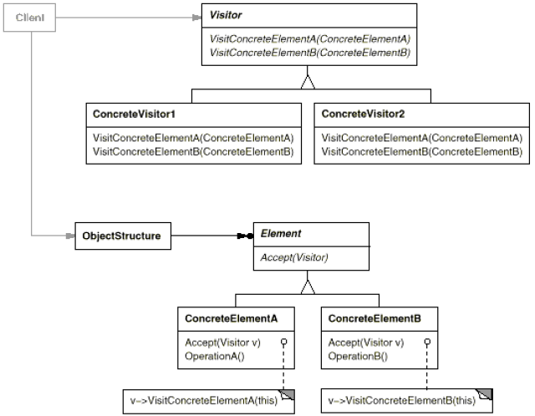
Visitor Pattern: Structure
Structure
Apr-21
Software Engineering

Slide 146
Visitor Pattern: Participant
Visitor (NodeVisitor)
declares a Visit operation for each class of ConcreteElement in the object structure. The operation's name and signature identifies the class that sends the Visit request to the visitor. That lets the visitor determine the concrete class of the element being visited. Then the visitor can access the element directly through its particular interface.
Apr-21
Software Engineering

Slide 147
Visitor Pattern: Participant
ConcreteVisitor
implements each operation declared by Visitor. Each operation implements a fragment of the algorithm defined for the corresponding class of object in the structure. ConcreteVisitor provides the context for the algorithm and stores its local state. This state often accumulates results during the traversal of the structure.
Apr-21
Software Engineering

Slide 148
Visitor Pattern: Participant
Element (Node)
defines an Accept operation that takes a visitor as an argument.
ConcreteElement
implements an Accept operation that takes a visitor as an argument.
Apr-21
Software Engineering

Slide 149
Visitor Pattern: Participant
ObjectStructure
can enumerate its elements.
may provide a high-level interface to allow the visitor to visit its elements.
may either be a composite or a collection such as a list or a set.
Apr-21
Software Engineering

Slide 150
Visitor Pattern: Collaboration
A client that uses the Visitor pattern must create a ConcreteVisitor object and then traverse the object structure, visiting each element with the visitor.
When an element is visited, it calls the Visitor operation that corresponds to its class. The element supplies itself as an argument to this operation to let the visitor access its state, if necessary.
Apr-21
Software Engineering

Slide 151
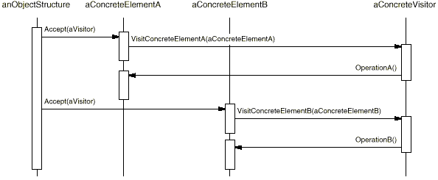
Visitor Pattern: Collaboration
The following interaction diagram illustrates the collaborations between an object structure, a visitor, and two elements:
Apr-21
Software Engineering

Slide 152
Visitor Pattern: Consequences
Visitor makes adding new operations easy.
Visitors make it easy to add operations that depend on the components of complex objects. You can define a new operation over an object structure simply by adding a new visitor. In contrast, if you spread functionality over many classes, then you must change each class to define a new operation.
Apr-21
Software Engineering

Slide 153
Visitor Pattern: Consequences
A visitor gathers related operations and separates unrelated ones.
Related behavior isn't spread over the classes defining the object structure; it's localized in a visitor. Unrelated sets of behavior are partitioned in their own visitor subclasses. That simplifies both the classes defining the elements and the algorithms defined in the visitors. Any algorithm-specific data structures can be hidden in the visitor.
Apr-21
Software Engineering

Slide 154
Visitor Pattern: Consequences
Adding new ConcreteElement classes is hard.
The Visitor pattern makes it hard to add new subclasses of Element. Each new ConcreteElement gives rise to a new abstract operation on Visitor and a corresponding implementation in every ConcreteVisitor class. If the Element class hierarchy is stable, but you are continually adding operations or changing algorithms, then the Visitor pattern will help you manage the changes.
Apr-21
Software Engineering

Slide 155
Visitor Pattern: Consequences
Visiting across class hierarchies.
An iterator can visit the objects in a structure as it traverses them by calling their operations. But an iterator can't work across object structures with different types of elements. All elements the iterator can visit have a common parent class Item.
template <class Item> class Iterator { // ...
Item CurrentItem() const;
};
Apr-21
Software Engineering

Slide 156
Visitor Pattern: Consequences
Visitor does not have this restriction. It can visit objects that don't have a common parent class. You can add any type of object to a Visitor interface. For example, in
class Visitor { public: // ...
void VisitMyType(MyType*);
void VisitYourType(YourType*);
};
MyType and YourType do not have to be related through inheritance at all.
Apr-21
Software Engineering

Slide 157
Visitor Pattern: Consequences
Accumulating state
Visitors accumulate state as they visit each element in the object structure. W/o a visitor, this state would be passed as extra arguments to the operations that perform the traversal, or appear as global.
Breaking encapsulation
Visitor's assumes that the ConcreteElement interface is powerful enough to let visitors do their job. As a result, the pattern often forces you to provide public operations that access an element's internal state
Apr-21
Software Engineering

Slide 158
Visitor Pattern: Implementation
Each object structure will have an associated abstract Visitor class.
This class declares a VisitConcreteElement operation for each class of ConcreteElement of the object structure.
Each Visit operation on the Visitor declares its argument to be a particular ConcreteElement, allowing the Visitor to access the interface of the ConcreteElement directly.
ConcreteVisitor classes override each Visit operation to implement visitor-specific behavior for the corresponding ConcreteElement class.
Apr-21
Software Engineering

Slide 159
Visitor Pattern: Implementation
The Visitor class would be declared like this in C++:
class Visitor {
public:
virtual void VisitElementA(ElementA*);
virtual void VisitElementB(ElementB*);
// and so on for other concrete elements
protected:
Visitor();
};
Apr-21
Software Engineering

Slide 160
Visitor Pattern: Implementation
Each class of ConcreteElement implements an Accept operation that calls the matching Visit... operation on the visitor for that ConcreteElement.
Thus the operation that ends up getting called depends on both the class of the element and the class of the visitor.
Apr-21
Software Engineering

Slide 161
Visitor Pattern: Implementation
The concrete elements are declared as:
class Element {
public: virtual ~Element();
virtual void Accept(Visitor&) = 0;
protected: Element(); };
class ElementA : public Element {
public: ElementA();
virtual void Accept(Visitor& v) { v.VisitElementA(this); } };
class ElementB : public Element {
public: ElementB();
virtual void Accept(Visitor& v) { v.VisitElementB(this); } };
Apr-21
Software Engineering

Slide 162
Visitor Pattern: Implementation
Double dispatch.
Effectively, the Visitor pattern lets you add operations to classes without changing them. Visitor achieves this by using a technique called double-dispatch.
"Double-dispatch" simply means the operation that gets executed depends on the kind of request and the types of two receivers. Accept is a double-dispatch operation. Its meaning depends on two types: the Visitor's and the Element's. Double-dispatching lets visitors request different operations on each class of element.
This is the key to the Visitor pattern.
Apr-21
Software Engineering

Slide 163
Visitor Pattern
Known Uses
Graphics toolkits
Related Patterns
Composite
Interpreter
Apr-21
Software Engineering

Slide 164
Factory Method Design Pattern
Virtual Constructors for Objects
Apr-21
Software Engineering
Notes:
‹#›

Slide 165
Factory Pattern
Destructors can be virtual.
They should be virtual to clean up a hierarchy of objects.
Can the Constructor be virtual?
Where is the objects?
Can I parameterize class in object creation, say, create a class by name?
Given classes “TextFile” & “ImageFile” I want to say – CreateObject(“TextFile”) …
Factory Pattern has answers
Apr-21
Software Engineering

Slide 166
Factory Pattern
Pattern Name and Classification:
Factory Method
Creational
Intent
Define an interface for creating an object, but let subclasses decide which class to instantiate. Factory Method lets a class defer instantiation to subclasses.
Also Known As
Virtual Constructor
Apr-21
Software Engineering

Slide 167
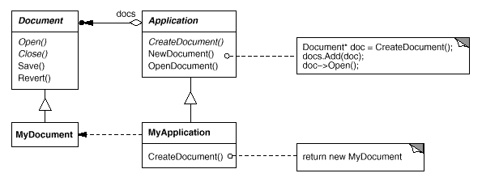
Factory Pattern: Motivation
Need a framework for Applications to create multiple types of Documents
Apr-21
Software Engineering

Slide 168
Factory Pattern: Motivation
Application class is responsible for creation (and management) of Documents
Problem:
Application class knows: WHEN a new document should be created
Application class doesn’t know: WHAT KIND of document to create
Solution:
Application defines a virtual function, createDocument()
MyApplication makes sure that createDocument() will create a product (Document) of the correct type.
Apr-21
Software Engineering

Slide 169
Factory Pattern: Applicability
A class can't anticipate the class of objects it must create.
A class wants its subclasses to specify the objects it creates.
Classes delegate responsibility to one of several helper subclasses, and you want to localize the knowledge of which helper subclass is the delegate.
Apr-21
Software Engineering

Slide 170
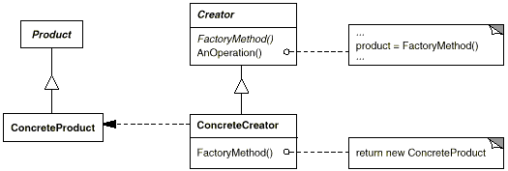
Factory Pattern: Structure
Structure
Apr-21
Software Engineering

Slide 171
Factory Pattern: Participant
Product (Document)
defines the interface of objects the factory method creates.
ConcreteProduct (MyDocument)
implements the Product interface.
Apr-21
Software Engineering

Slide 172
Factory Pattern: Participant
Creator (Application)
declares the factory method, which returns an object of type Product. Creator may also define a default implementation of the factory method that returns a default ConcreteProduct object.
may call the factory method to create a Product object.
ConcreteCreator (MyApplication)
overrides the factory method to return an instance of a ConcreteProduct.
Apr-21
Software Engineering

Slide 173
Factory Pattern: Collaboration
Creator relies on its subclasses to define the factory method so that it returns an instance of the appropriate ConcreteProduct.
Apr-21
Software Engineering

Slide 174
Factory Pattern: Consequences
Factory methods eliminate the need to bind application-specific classes into code. The code only deals with the Product interface; therefore it can work with any user-defined ConcreteProduct classes.
A potential disadvantage of factory methods is that clients might have to subclass the Creator class just to create a particular ConcreteProduct object.
Apr-21
Software Engineering

Slide 175
Factory Pattern: Consequences
Provides hooks for subclasses. Creating objects inside a class with a factory method is always more flexible than creating an object directly. Factory Method gives subclasses a hook for providing an extended version of an object.
Apr-21
Software Engineering

Slide 176
Factory Pattern: Consequences
Connects parallel class hierarchies. Parallel class hierarchies result when a class delegates some of its responsibilities to a separate class.
Example:
Graphical figures and their
Manipulators – to stretch, move, or rotate by the mouse.
Apr-21
Software Engineering

Slide 177
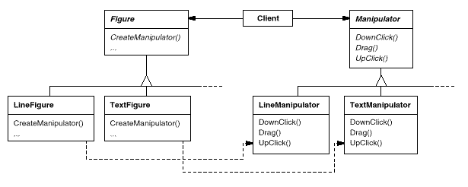
Factory Pattern: Consequences
Apr-21
Software Engineering

Slide 178
Factory Pattern: Implementation
Two major varieties.
The Creator class is an abstract class and does not provide an implementation for the factory method it declares.
The Creator is a concrete class and provides a default implementation for the factory method.
Apr-21
Software Engineering

Slide 179
Factory Pattern: Implementation
Parameterized factory methods.
Lets the factory method create multiple kinds of products.
The factory method takes a parameter that identifies the kind of object to create.
All objects the factory method creates will share the Product interface.
Document example: Application supports different kinds of Documents. Pass an extra (type of document) parameter to CreateDocument
Apr-21
Software Engineering

Slide 180
Factory Pattern: Implementation
class Creator {
public:
virtual Product* Create(ProductId);
};
Product* Creator::Create (ProductId id) {
if (id == MINE) return new MyProduct;
if (id == YOURS) return new YourProduct;
// repeat for remaining products...
return 0;
}
Apr-21
Software Engineering

Slide 181
Factory Pattern: Implementation
class MyCreator: public Creator {
// ...
}
Product* MyCreator::Create (ProductId id) {
if (id == YOURS) return new MyProduct;
if (id == MINE) return new YourProduct;
// N.B.: switched YOURS and MINE
if (id == THEIRS) return new TheirProduct;
// called if all others fail
return Creator::Create(id);
}
Apr-21
Software Engineering

Slide 182
Factory Pattern: Implementation
Using templates to avoid subclassing.
‘Id’-based switching in the last approach is error-prone (you cannot check if the right constructor has been called for the Id).
Provide a template subclass of Creator that's parameterized by the Product class.
Apr-21
Software Engineering

Slide 183
Factory Pattern: Implementation
class Creator {
public: virtual Product* CreateProduct() = 0;
};
template <class TheProduct>
class StandardCreator: public Creator {
public: virtual Product* CreateProduct();
};
template <class TheProduct>
Product* StandardCreator<TheProduct>::CreateProduct(){
return new TheProduct;
}
Apr-21
Software Engineering

Slide 184
Factory Pattern: Implementation
class MyProduct : public Product {
public:
MyProduct();
// ...
};
StandardCreator<MyProduct> myCreator;
Apr-21
Software Engineering

Slide 185
Factory Pattern
Known Uses
Factory methods pervade toolkits and frameworks
Related Patterns
Abstract Factory
Template Methods
Prototype
Apr-21
Software Engineering

Slide 186
Abstract Factory Design Pattern
Variant Strategies for Creation
Apr-21
Software Engineering
Notes:
‹#›

Slide 187
Abstract Factory Pattern
Pattern Name and Classification:
Abstract Factory
Creational
Intent
Provide an interface for creating families of related or dependent objects without specifying their concrete classes.
Also Known As
Kit
Apr-21
Software Engineering

Slide 188
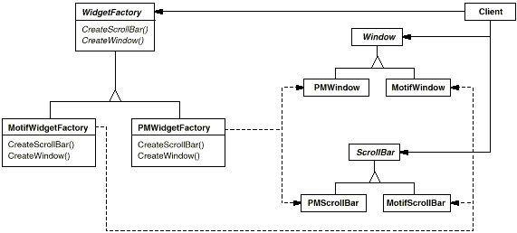
Abstract Factory Pattern: Motivation
Different GUI’s have different look-and-feel
Motif
Product Manager (PM)
Apr-21
Software Engineering

Slide 189
Abstract Factory Pattern: Applicability
a system should be independent of how its products are created, composed, and represented.
a system should be configured with one of multiple families of products.
a family of related product objects is designed to be used together, and you need to enforce this constraint.
you want to provide a class library of products, and you want to reveal just their interfaces, not their implementations.
Apr-21
Software Engineering

Slide 190
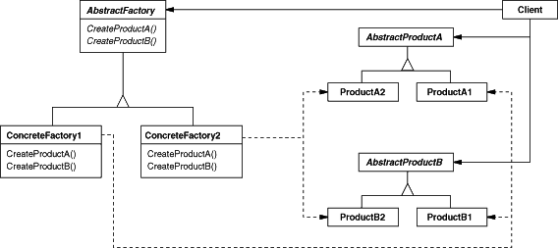
Abstract Factory Pattern: Structure
Structure
Apr-21
Software Engineering

Slide 191
Abstract Factory Pattern: Participant
AbstractFactory (WidgetFactory)
declares an interface for operations that create abstract product objects.
ConcreteFactory (MotifWidgetFactory, PMWidgetFactory)
implements the operations to create concrete product objects.
Apr-21
Software Engineering

Slide 192
Abstract Factory Pattern: Participant
AbstractProduct (Window, ScrollBar)
declares an interface for a type of product object.
ConcreteProduct (MotifWindow, MotifScrollBar)
defines a product object to be created by the corresponding concrete factory.
implements the AbstractProduct interface.
Apr-21
Software Engineering

Slide 193
Abstract Factory Pattern: Participant
Client
uses only interfaces declared by AbstractFactory and AbstractProduct classes.
Apr-21
Software Engineering

Slide 194
Factory Pattern: Participant
Creator (Application)
declares the factory method, which returns an object of type Product. Creator may also define a default implementation of the factory method that returns a default ConcreteProduct object.
may call the factory method to create a Product object.
ConcreteCreator (MyApplication)
overrides the factory method to return an instance of a ConcreteProduct.
Apr-21
Software Engineering

Slide 195
Abstract Factory Pattern: Collaborations
Normally a single instance of a ConcreteFactory class is created at run-time. This concrete factory creates product objects having a particular implementation. To create different product objects, clients should use a different concrete factory.
AbstractFactory defers creation of product objects to its ConcreteFactory subclass.
Apr-21
Software Engineering

Slide 196
Abstract Factory Pattern: Consequences
It isolates concrete classes.
It makes exchanging product families easy.
It promotes consistency among products.
Supporting new kinds of products is difficult.
Apr-21
Software Engineering

Slide 197
Factory Pattern
Known Uses
Graphics Kits
Related Patterns
Factory Method
Singleton
Prototype
Apr-21
Software Engineering

Slide 198
Thank You
Apr-21
Software Engineering
Notes:
‹#›

